Slide 1
Student Grade Performance
Borjan Kalinoski
Semih Ismaili

Slide 2
The Dataset
Student achievement in secondary education of two Portuguese schools. The attributes include student grades, demographic, social and other school related features.

Slide 3
Attributes
School
Sex
Age
Adress
Famsize
Pstatus
Medu
Fedu
Mjob
Fjob
Reason
Guardian
Traveltime
Studytime
Failures
Schoolsup
Famsup
Paid
Activities
Nursery
Higher
Internet
Romantic
Famrel
Freetime
Goout
Dalc
Walc
Health
Absences
G1
G2
G3

Slide 4
Target Attribute
G3 - final 3rd period grade (numeric: from 0 to 20, output target)
Strongly correlated with:
G1 – 1st period grade (numeric: from 0 to 20) G2 – 2nd period grade (numeric: from 0 to 20)
It is more difficult to predict G3 without G1 or G2, although such prediction would be more useful, we are limited to just under 400 instances of students in our dataset.

Slide 5
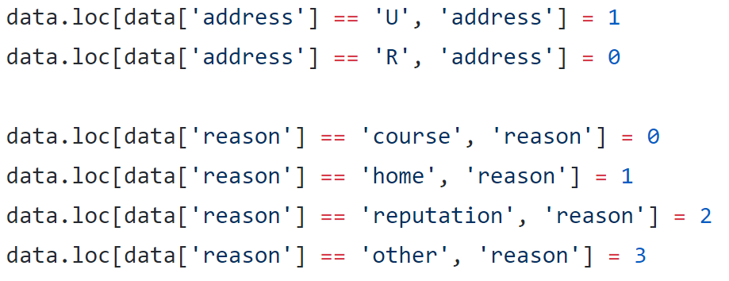
Utilization of the data
The attributes mostly had string values, even when they were merely binary attributes
In order to make the data useful for mathematical calculations we converted most of the data types to integers

Slide 6
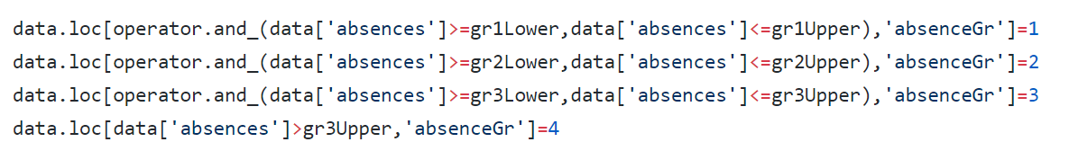
Since the absence attribute seemed important and had values varying all over the place
We decided to break the absences down to 4 classes and add them as a new attribute
absenceGr

Slide 7
Visualization
In order to understand the data better and make feature selection easier we plotted various graphs using the matplotlib library in python

